Slide 1
Concurrency Control
Parteek Kumar

Slide 2
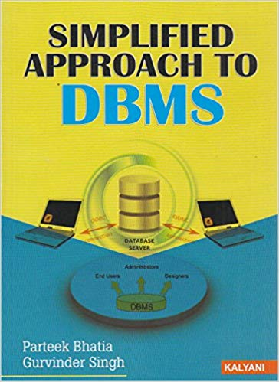
Locking Techniques for Concurrency Control
Some of the main techniques used to control concurrent execution of transactions are based on the concept of locking data items.
What is Lock?
A lock is a variable associated with a data item that describes the status of the item with respect to possible operations that can be applied to it. Generally, there is one lock for each data item in the database. Locks are used as a means of synchronizing the access by concurrent transactions to the database items.
Types of Locks
Several types of locks are used in concurrency control. To introduce locking concepts gradually, we first discuss binary locks, which are simple but restrictive and so are not used in practice. We then discuss shared/exclusive locks, which provide more general locking capabilities and are used in practical database locking schemes.
Simplified Approach to DBMS By Parteek Bhatia

Slide 3
Binary Locks
A binary lock can have two states or values: locked and unlocked.
A distinct lock is associated with each database item A. If the value of the lock on A is 1, item A cannot be accessed by a database operation that requests the item. If the value of the lock on A is 0, then item can be accessed when requested. We refer to the current value of the lock associated with item A as LOCK(A).There are two operations, lock_item and unlock_item are used with binary locking. A transaction requests access to an item A by first issuing a lock_item(A) operation. if Lock(A)=1, the transaction is forced to wait. If LOCK(A) =0 it is set to 1 (the transaction locks the item) and the transaction is allowed to access item A. When the transaction is through using the item, it issues an unlock_item(A) operation, which sets LOCK(A) to 0(unlocks the item) so that A may be accessed by other transactions. Hence a binary lock enforces mutual exclusion on the data item.
Simplified Approach to DBMS By Parteek Bhatia

Slide 4
Disadvantages of Binary Locks
As discussed earlier, binary locking scheme is too restrictive for database items, because at most one transaction can hold a lock on a given item. So, binary locking system cannot be used for practical purpose.
Simplified Approach to DBMS By Parteek Bhatia

Slide 6
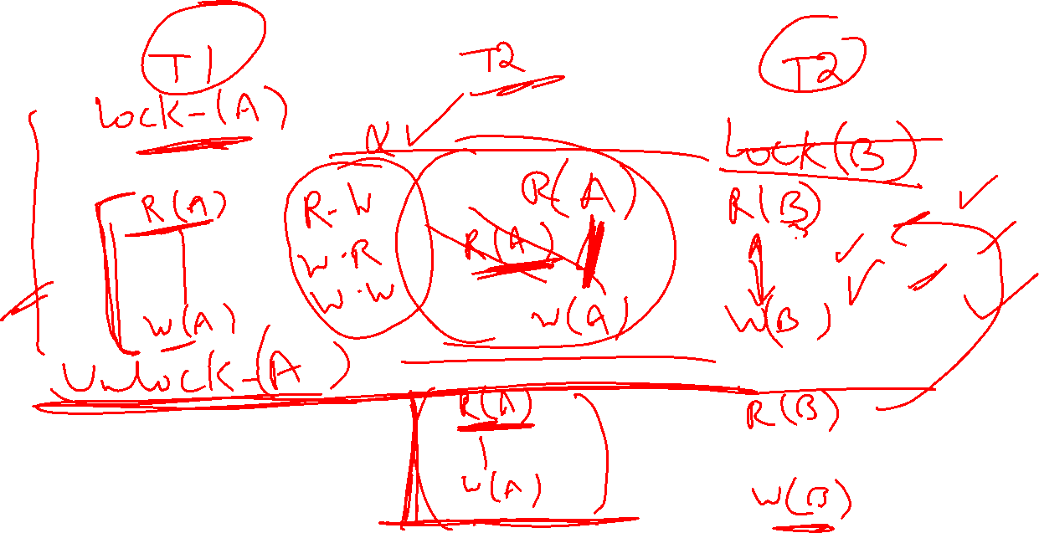

Slide 7
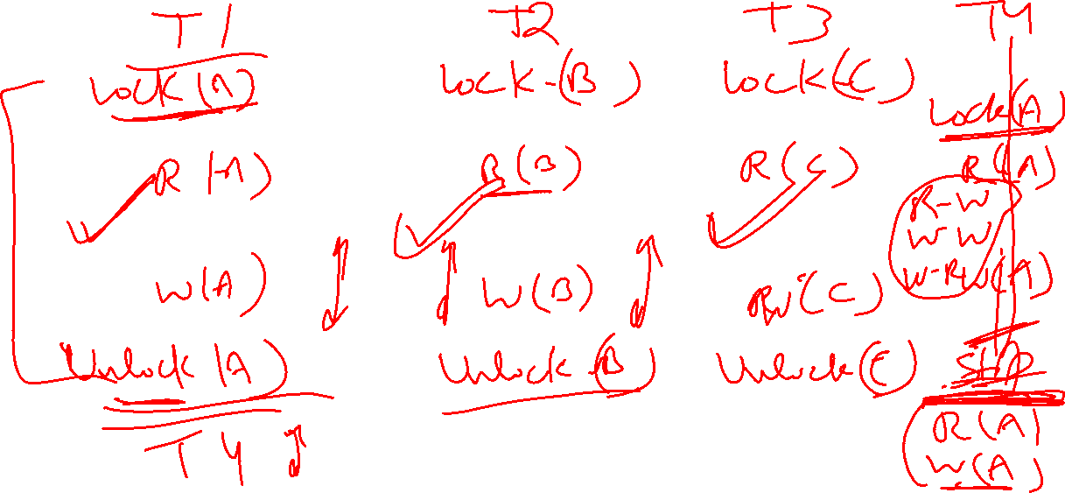

Slide 8
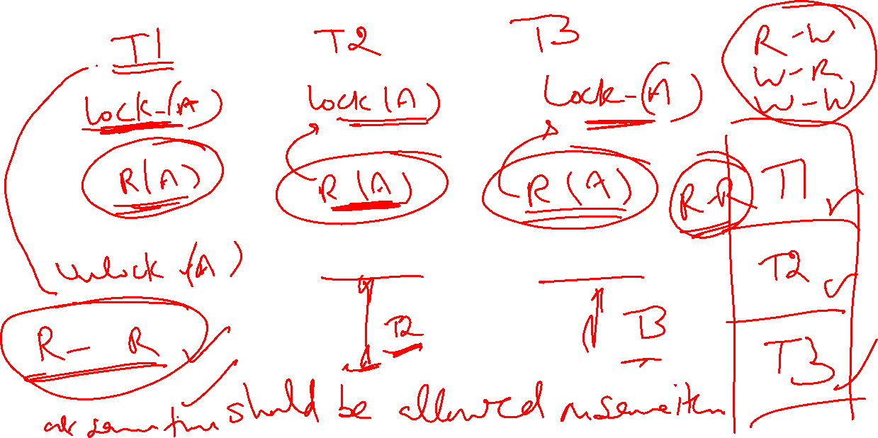

Slide 9
Share/Exclusive (for Read/Write) Locks
We should allow several transactions to access the same item A if they all access A for reading purposes only. However, if a transaction is to write an item A, it must have exclusive access to A. For this purpose, a different type of lock called a multiple-mode lock is used. In this scheme there are shared/exclusive or read/write locks are used.
Simplified Approach to DBMS By Parteek Bhatia

Slide 10
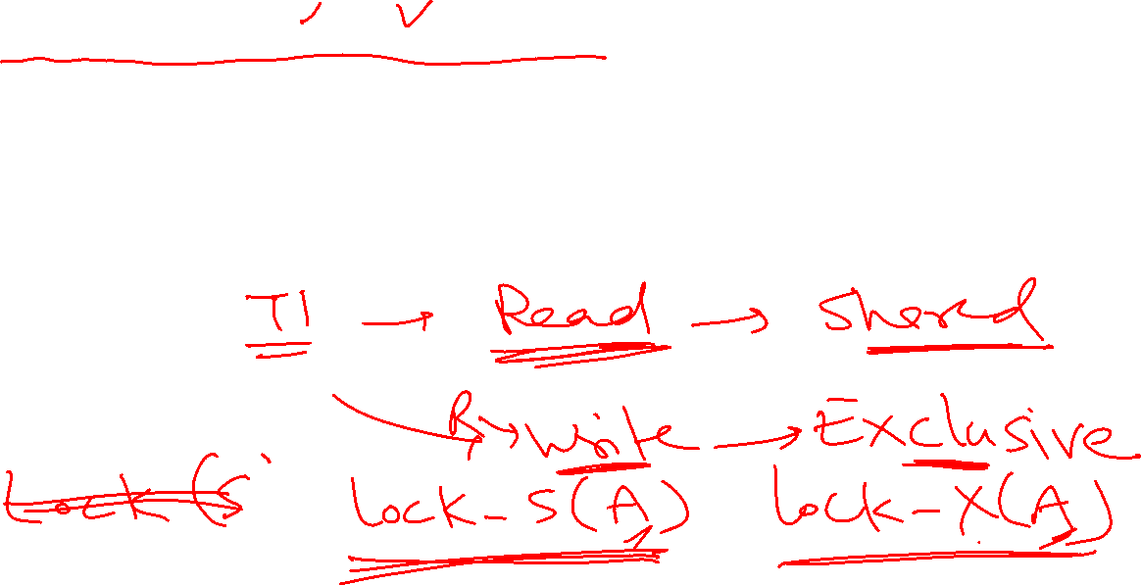
Share/Exclusive (for Read/Write) Locks
We should allow several transactions to access the same item A if they all access A for reading purposes only. However, if a transaction is to write an item A, it must have exclusive access to A. For this purpose, a different type of lock called a multiple-mode lock is used. In this scheme there are shared/exclusive or read/write locks are used.
Simplified Approach to DBMS By Parteek Bhatia

Slide 11
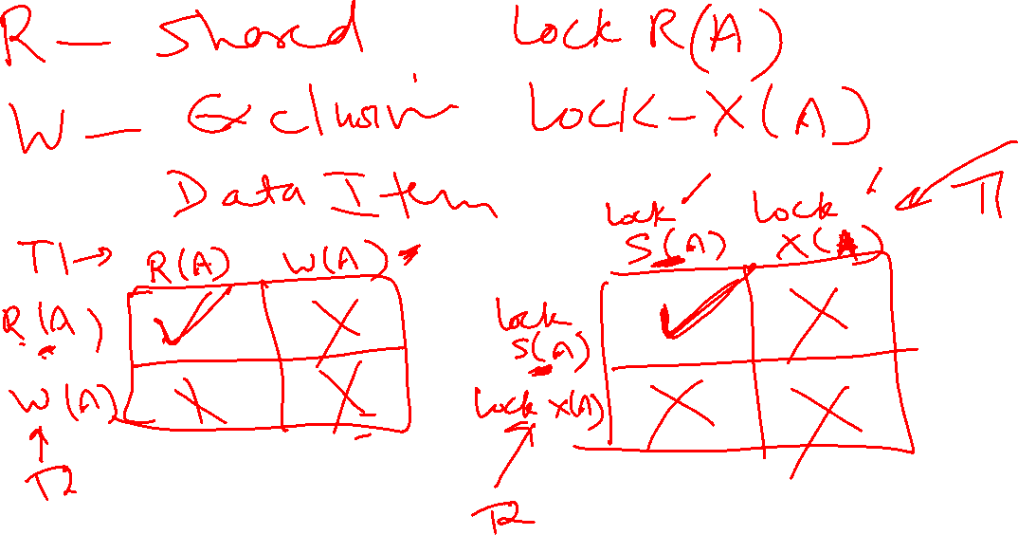

Slide 13
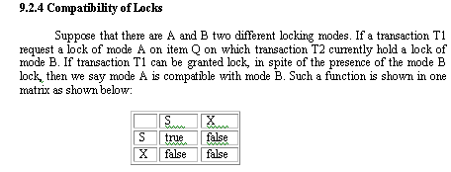
Simplified Approach to DBMS By Parteek Bhatia

Slide 14
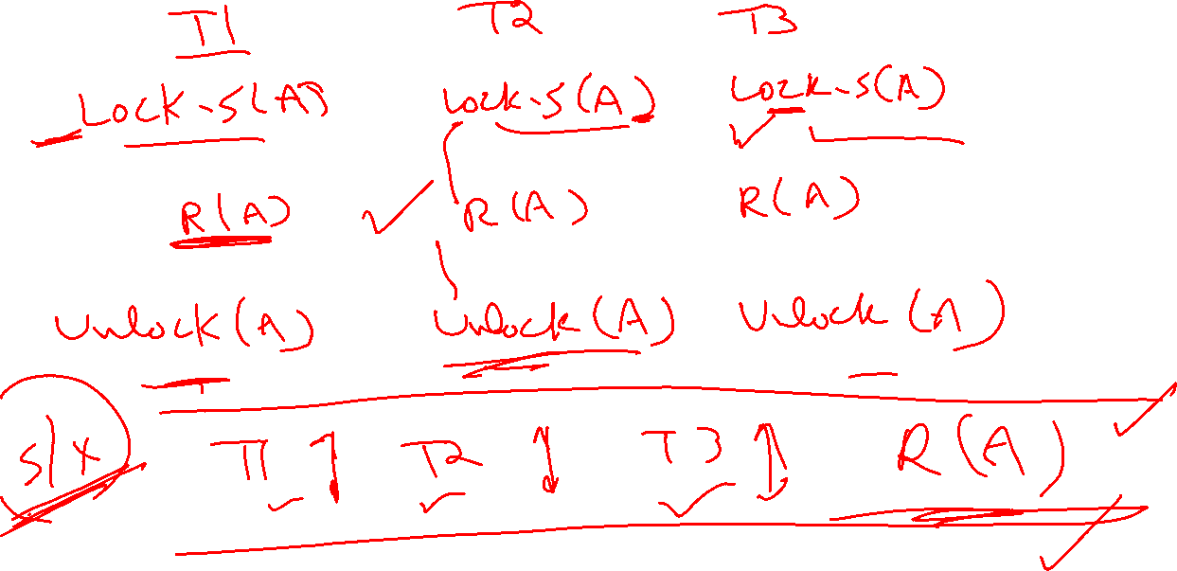

Slide 15
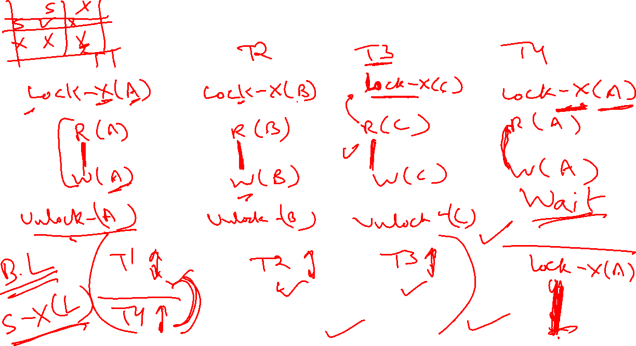

Slide 16
Example As an illustration consider the simplified banking system. Let A and B be two accounts that are accessed by transactions T1 and T2. Transaction T1 transfers Rs.50 from account B to account A and is defined as
T1
lock-X(B);
read(B,b) ;
b :=b-50 ;
write(B,b) ;
unlock(B) ;
lock-X(A)
read(A,a);
a:=a+50;
write(A,a);
unlock(A);
Simplified Approach to DBMS By Parteek Bhatia

Slide 17
Transaction T2 displays the total amount of money in accounts A and B that is, the sum A+B and is defined as
T2
lock-S(A);
read(A,a);
unlock(A);
lock-S(B);
read(B,b);
unlock(B);
display(a+b);
Simplified Approach to DBMS By Parteek Bhatia

Slide 18
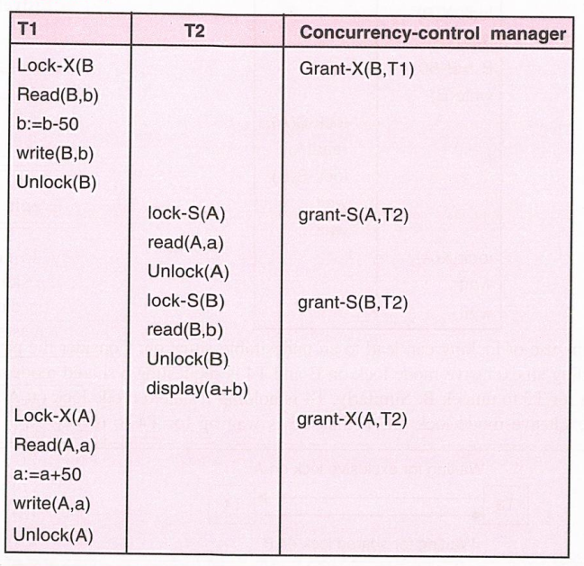
Simplified Approach to DBMS By Parteek Bhatia

Slide 19
Solution of Inconsistency Problem
Suppose now that unlocking is delayed to the end of the transaction. The transaction T3 corresponds to T1 with unlocking delayed and is defined as
T3
lock-X(B);
read(B,b) ;
b :=b-50 ;
write(B,b) ;
lock-X(A) ;
read(A,a);
a:=a+50;
write(A,a);
unlock(B);
unlock(A);
Simplified Approach to DBMS By Parteek Bhatia

Slide 22
Transaction T4 corresponds to T2 with unlocking delayed, and is defined as
T4
lock-S(A);
read(A,a);
lock-S(B);
read(B,b);
display(a+b);
unlock(A);
unlock(B);
Simplified Approach to DBMS By Parteek Bhatia

Slide 23
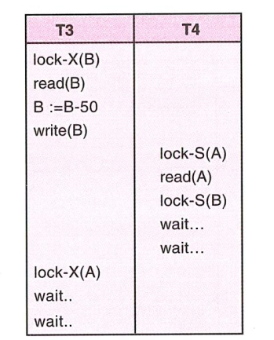
Simplified Approach to DBMS By Parteek Bhatia

Slide 24

Simplified Approach to DBMS By Parteek Bhatia

Slide 25
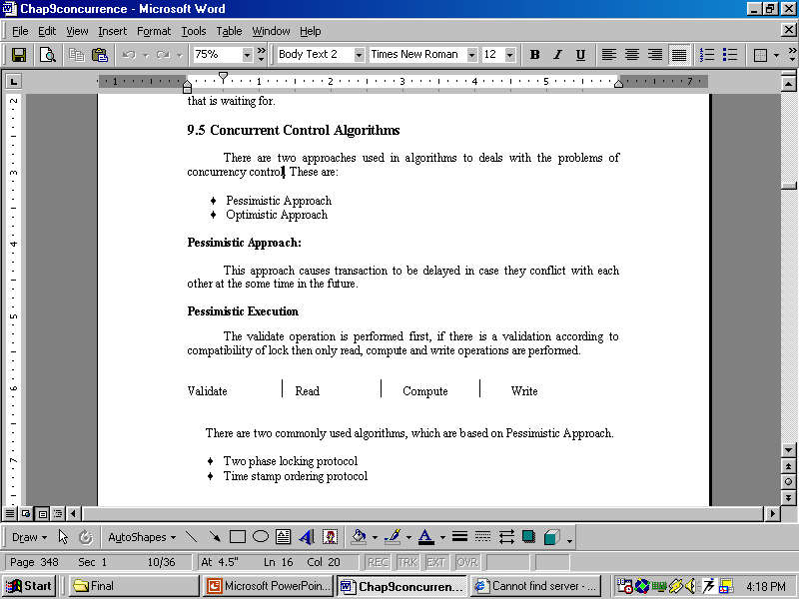
Simplified Approach to DBMS By Parteek Bhatia

Slide 26
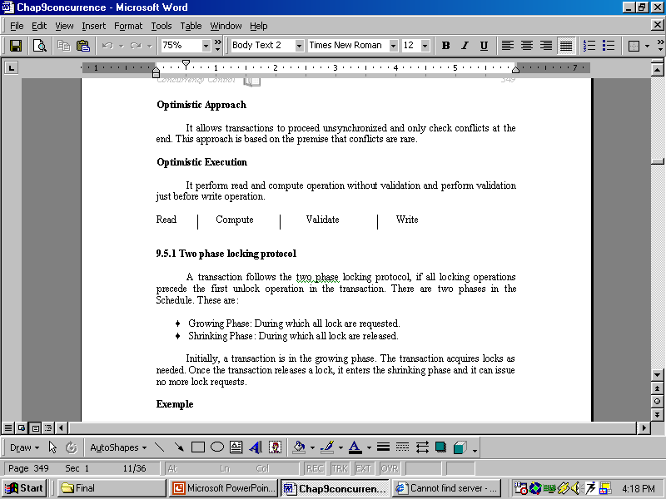
Simplified Approach to DBMS By Parteek Bhatia

Slide 27
Problems with two-phase locking protocols
There are two problems with two-phase locking protcol.These are:
1. Deadlock
2. Cascading roll-back
Deadlock
As discussed above, two-phase locking does not ensure freedom from deadlock. As shown in transaction T3 and T4 are in two phase, but still there is problem of deadlock.
Cascading roll-back
As shown in partial schedule shown on next page each transaction observers two-phase locking protocol.
Simplified Approach to DBMS By Parteek Bhatia

Slide 28
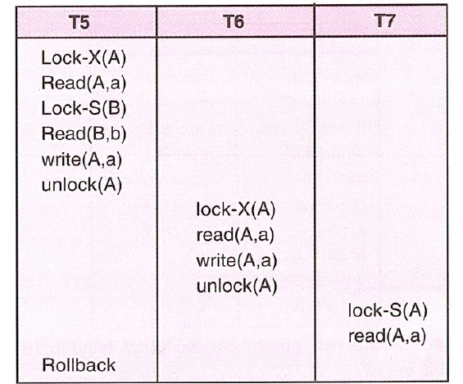
Simplified Approach to DBMS By Parteek Bhatia

Slide 29
Solutions to avoid cascading of rollbacks
There are two solutions to avoid cascading of rollback. These are:
♦ Strict two phase locking protocol (Only Exclusive Lock held until transaction commit)
♦ Rigorous two phase locking protocol (All the locks held until transaction commit)
Simplified Approach to DBMS By Parteek Bhatia

Slide 30
Conversion of Locks
In order to understand the conversion of locks first consider the following example
T8
read(A1,a1);
read(A2,a2);
…….
read(A_{n},a_{n});
……..
write(A1,a1);
Transaction T9 is defined as
T9
read(A1,a1);
read(A2,a2);
display(a1+a2);
Simplified Approach to DBMS By Parteek Bhatia

Slide 31
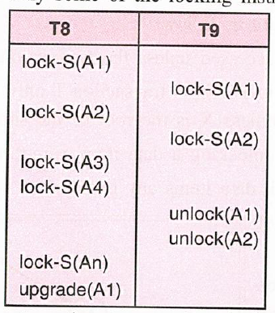
Simplified Approach to DBMS By Parteek Bhatia

Slide 32
Non two-phase locking protocol
In order to develop those protocols, which are not based on two phase locking technique, one must have additional information on how each transaction will access the database. There are various models that differ in the amount of such information required. There are two types of protocols which are not be on two phase locking scheme:
♦ Graph Based Protocol
♦ Time stamp-based Protocol
Simplified Approach to DBMS By Parteek Bhatia

Slide 33
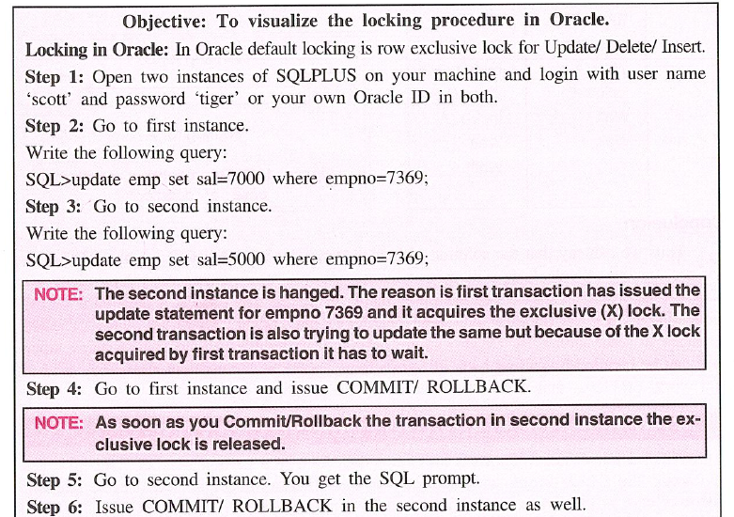
Simplified Approach to DBMS By Parteek Bhatia

Slide 34
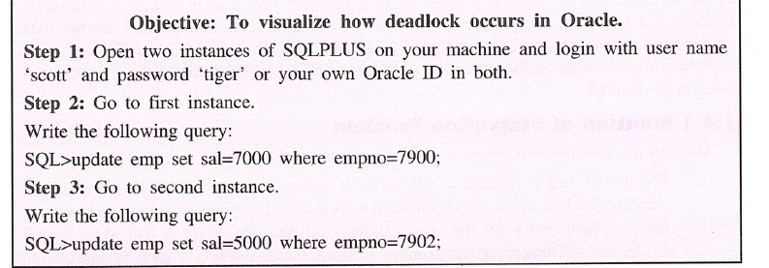
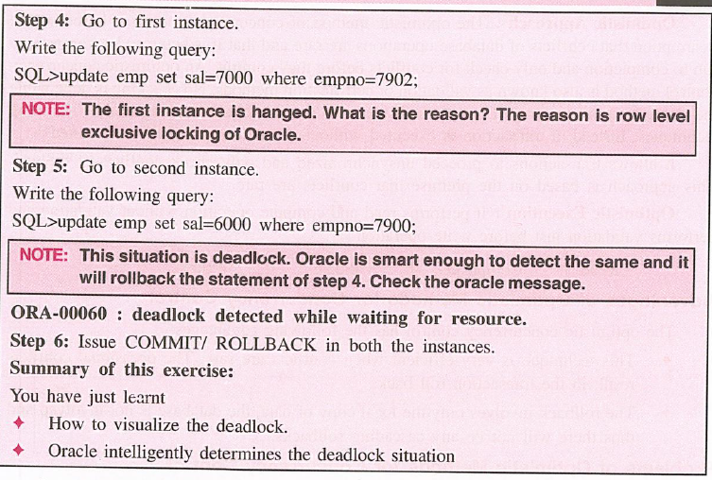
Simplified Approach to DBMS By Parteek Bhatia

